Slide 1

NYC AirBnB Price Predictor
Sushrut Madhavi
Mijeong Ban
Kurt Von Autenried
Theodore Jagodits

Slide 2

Introduction
Notes:
Why this is important

Slide 3

Why is this important
AirBnB becoming increasingly popular
Uber of hotel business
Cost effective for those travelling long distances
Hosts want to know quality of offer
Consumers want to know what a good deal is
Given a place to stay, what would be considered a reasonable price?

Slide 4

Goals and Applications
Use columns such as reviews, location and description to predict price
Find the best model that can give the best R2 score
Determine the deciding factors in models that have the greatest impact on the prediction
Using these deciding factors to give a business analysis to AirBnB hosts on how to improve reviews and price

Slide 5

Graphical Analysis

Slide 6

Dataset Summary
New York City Airbnb data for the year of 2019
Dataset obtained from kaggle, courtesy of www.insideairbnb.com
Contains information about hosts, geographical availability, price and several other metrics
Total number of rows: 48895
Columns (features): id, name, host_id, host_name, neighbourhood_group, neighbourhood, latitude, longitude, room_type, price, minumum_nights, number_of_reviews, last_review, reviews_per_month, calculated_host_listings_count, availability_365
Out of these columns, id, host_name and last_review are not relevant for prediction and may be safely dropped

Slide 7
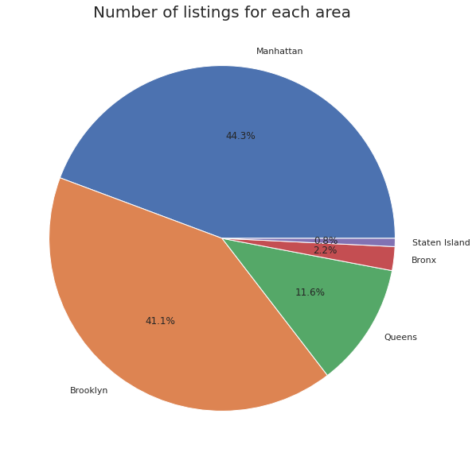

Share of Listings by Burrough
Notes:
value

Slide 8
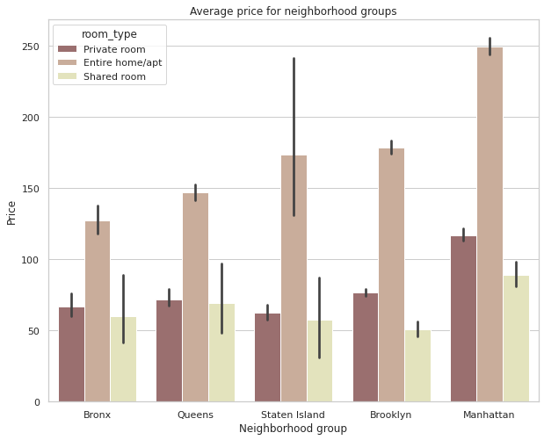
Room Type by Area

Slide 9
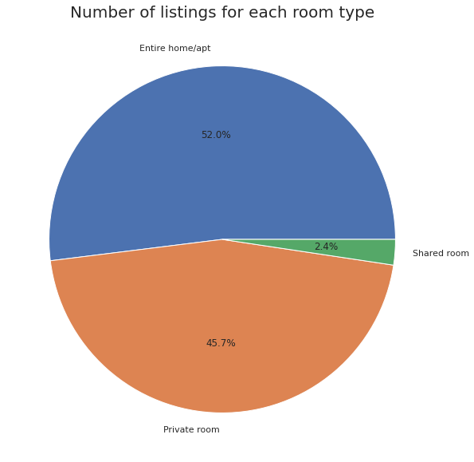

Share of Room Type
Notes:
value

Slide 10
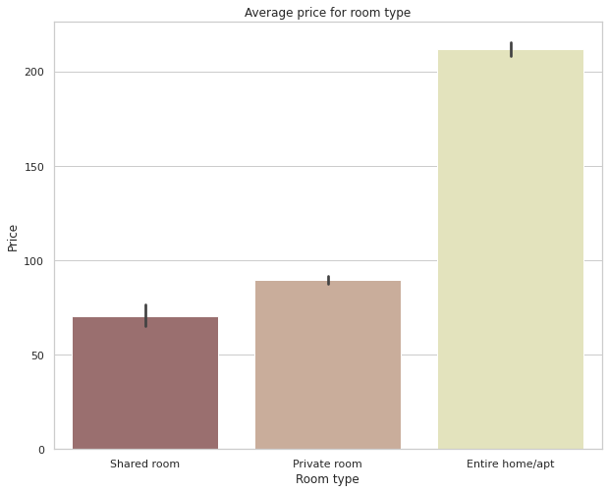
Room Type based on Avg. Price
Notes:
value

Slide 11
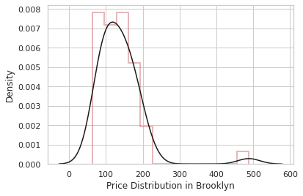
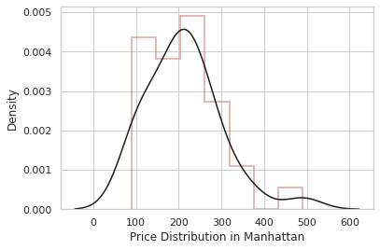
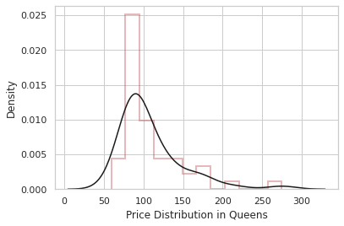
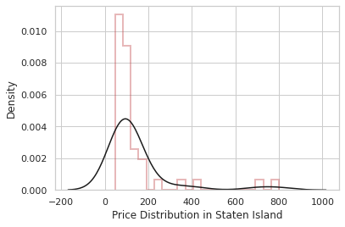

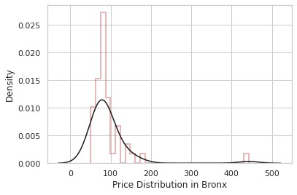
Price Distribution

Slide 12

Relationship between outcome variable (Price) and other features
Price varies mainly by area, room type and neighbourhood. More variation with the former 2 than the latter
Generally price increases greatly when moving to a more metropolitan area like Manhattan, but this change is not always regular
The change in price is observed much more clearly between different room categories - As expected, renting an entire apartment is the most expensive, followed by a single private room and sharing with a roommates being the cheapest
Finally, price also varies from host to host but this change does not seem follow any particular pattern

Slide 13
Modeling

Slide 14

Preprocessing
Data cleaning
Remove missing values
Check for outliers
Drop extraneous columns
Label Encoding for categorical variables
Split training and test sets
80-20 split
Notes:
Explain why we chose

Slide 15
Models
Models used:
Linear Regression
KNN
Support Vector Machine
Neural Networks
Decision Tree
Random Forest
XGBoost
All of these are regression version of models, not classifiers.

Slide 16

Best Model
Comparison of performance of different models:
Model | Mean Squared Error | Mean Absolute Error | R2 Score
Linear Regressor | 6674.559549 | 50.252100 | 0.443628
KNN Regressor | 5046.053980 | 41.222002 | 0.579375
Support Vector Machine | 7255.317737 | 47.717278 | 0.395218
Neural Network | 5239.603747 | 41.902355 | 0.563242
Decision Tree | 5652.013260 | 44.117490 | 0.528864
XGBoost | 4810.174979 | 39.87148943 | 0.59903759
Random Forest | 4455.089816 | 38.103864 | 0.628636
Notes:
** Need to explain what each measurement means
MSE
Based on square of error
Value lies between 0 to ∞
Sensitive to outliers
Small value indicates better model
MAE
Based on absolute value of error
Value lies between 0 to ∞
Treat larger and small errors equally. Not sensitive to outliers
Small value indicates better model
R2-score
Based on correlation between actual and predicted value
Value liked between 0 and 1
Not sensitive to outliers
Value near 1 indicates better model

Slide 17
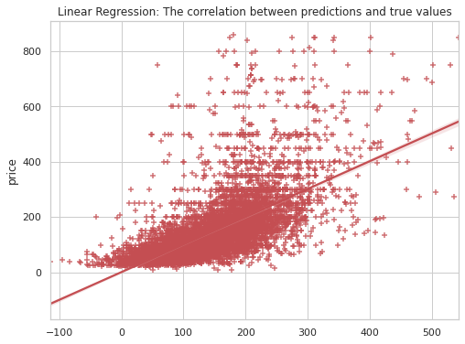
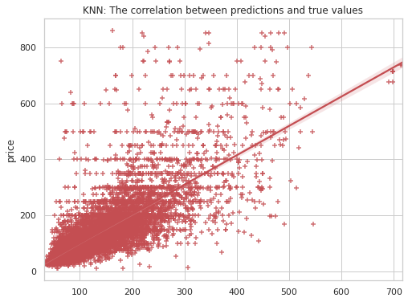
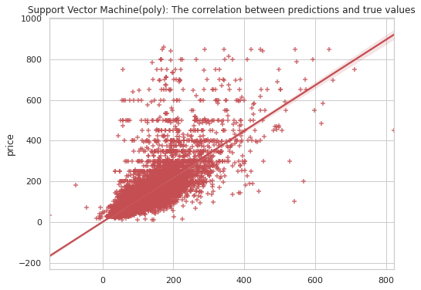
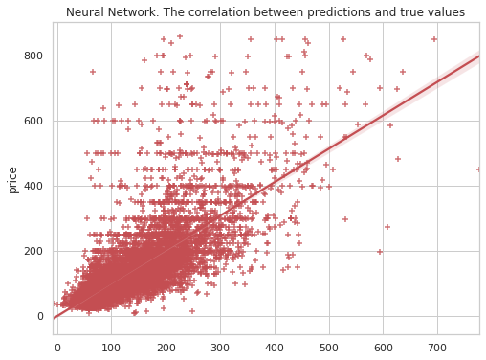
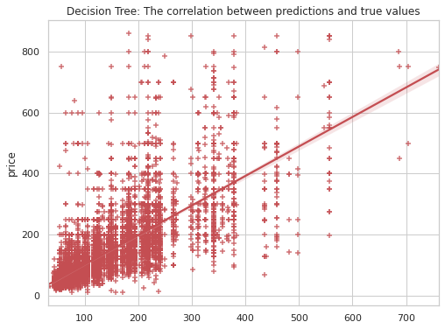
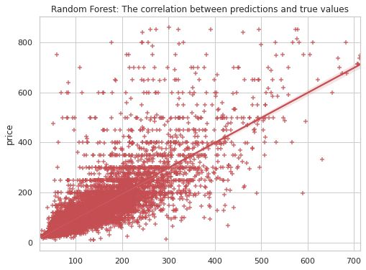
Correlation
Notes:
Those are showing correlation between prediction and true value.
Linear Regression, KNN, polySVM, Neural Network, Decision Tree, Random Forest

Slide 18
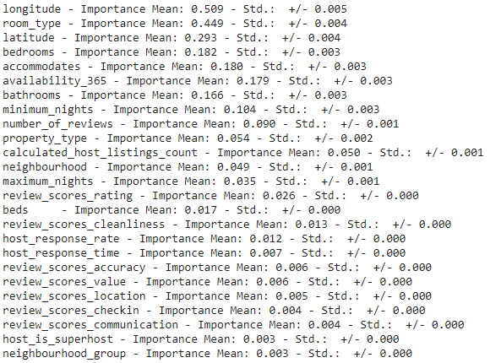

Factors:
What drives the models?
Location, location, location…
And other factors such as room type, # of bedrooms, # of people allowed.

Slide 19
Conclusion
Business Recommendations
Looking at the factors that drive the model, it looks like location is one of the most important factors. However looking more closely, the neighbourhood itself does not have a large impact on the model.
Number of people allowed and number of bedrooms are a large driving factor as well.
What does not determine the price as well is maximum nights, if the host is the superhost, and property type.

Slide 20
Questions? Thanks for listening.

